Slide 1


ST201B Final Project: Machine Learning Methods for Text Classification
By: Nick Kim and María Elisa Ramos-Sepúlveda
Prof. Chad Hazlett
March 7, 2022

Slide 2
Outline:
Introduction
Dataset
Procedure
Preprocessing
Modeling
Results
Discussion
Future Work

Slide 3
Introduction:
With the increase of digitized data comes the need of efficient ways to organize and retrieve data.
Text classification is a machine learning scheme used in information management applications to automatically allocate text-data into predefined categories.
Classifying research papers into correct subjects (e.g. statistics) using only their titles.

Slide 4

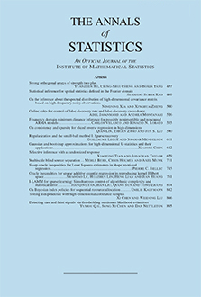


Dataset:
Papers scraped from websites of academic journals
Categories: Journals/Subjects
Features: Titles
Size: 1917 titles, 4 classes
(Computational) limitations

Slide 5
Procedure:
Preprocessing
Only keep titles in English
Tokenize
Remove noise (punctuation, upper cases, numbers, stopwords)
Stem
Original | Tokenized | Noise Removed | Stemmed
On the adaptive elastic-net with a diverging number of parameters | On, the, adaptive, elastic-net, with, a, diverging, number, of, parameters | adaptive, elasticnet, diverging, number, parameters | adap, elasticnet, diverg, number, paramet

Slide 6
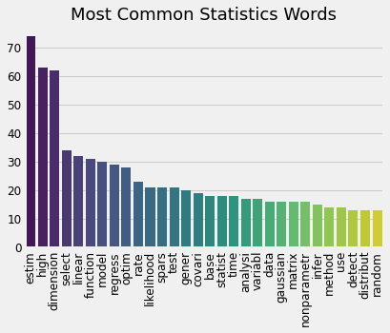
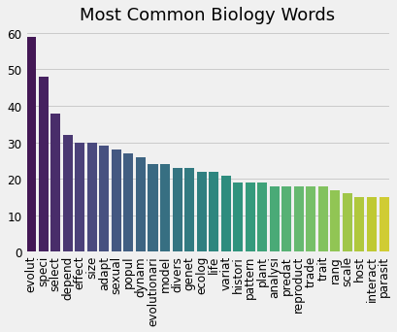
Procedure:
Most common (stemmed) words by count

Slide 7
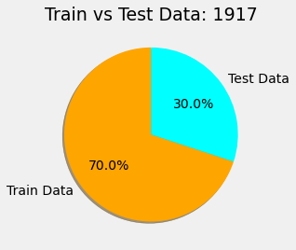
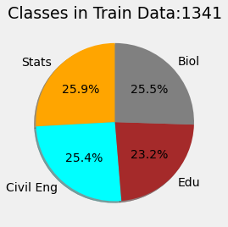
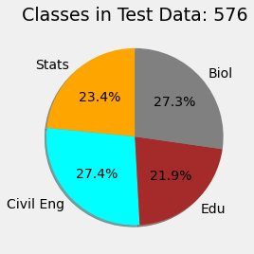
Procedure:
Train-test split
70% in training set, 30% in test set

Slide 8
Procedure:
Vectorization
Count: # of times word appears in corpus
TF-IDF: count with a weighting factor
 | Blue | Bright | Sky | Sun
Text 1 | 1 | 0 | 1 | 0
Text 2 | 0 | 1 | 0 | 1
Text 3 | 1 | 1 | 0 | 1
 | Blue | Bright | Sky | Sun
Text 1 | 0.707 | 0 | 0.707 | 0
Text 2 | 0 | 0.707 | 0 | 0.707
Text 3 | 0.707 | 0.707 | 0 | 0.707

Slide 9
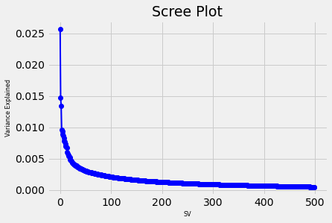
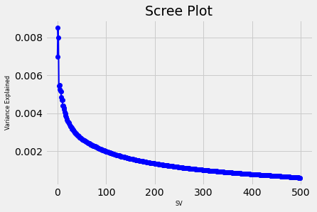
Procedure:
Normalization
Dimension Reduction
Truncated SVD
Count
TF-IDF

Slide 10
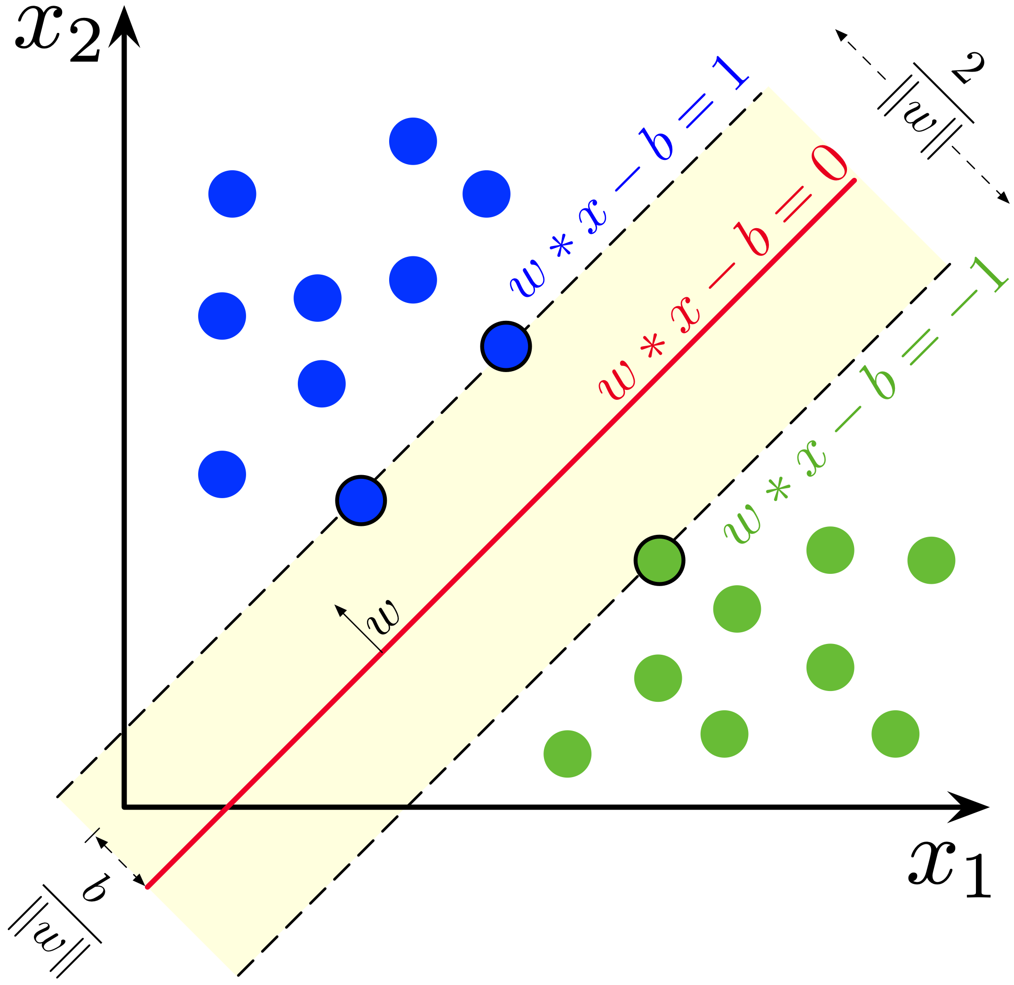
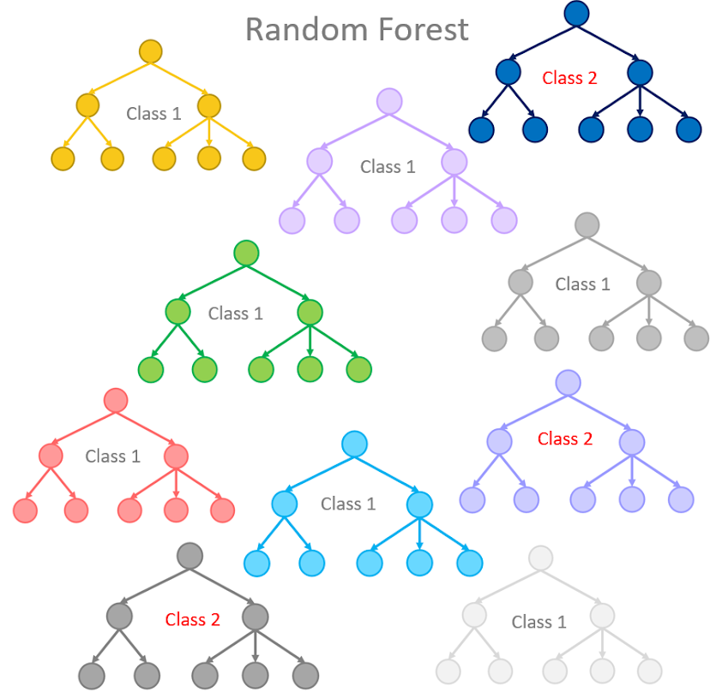
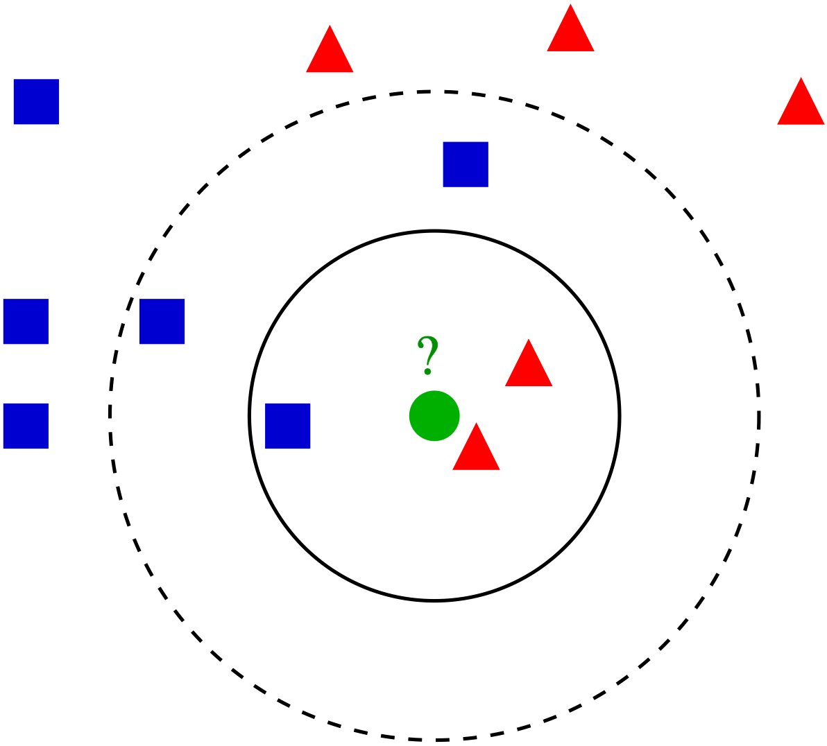
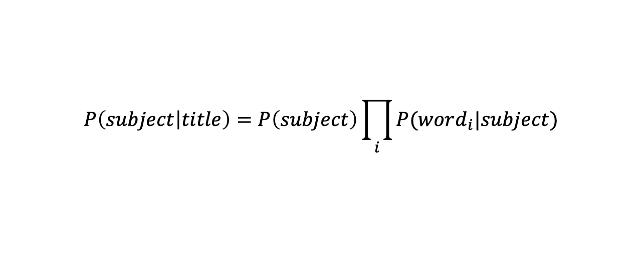
Procedure:
Naïve Bayes Classifier
$$P\left(subject | title\right)=P\left(subject\right)\prod_{i}{P(word_{i}|subject)}$$
SVM
Random Forest
K-nearest neighbors

Slide 11
Results:
Measured the proportion of correctly classified papers for each model
Method | Accuracy (using Count Vectorizer) | Accuracy (using TF-IDF Vectorizer)
Naïve Bayes Classifier | 0.970 | 0.961
Support Vector Machine | 0.943 | 0.962
Random Forest | 0.887 | 0.909
K-Nearest Neighbors | 0.910 | 0.935

Slide 12
Results:
Failed classifications from Naïve Bayes Classifier
Count Vectorizer:
TF-IDF Vectorizer:
Title | Stats | Ci Eng | Edu | Bio
Model adequacy and the macroevolution of angiosperm functional traits | -17.09 | -20.596 | -21.043 | -17.32
Theory of disagreement-based active learning | -12.925 | -15.784 | -10.746 | -16.383
Title | Stats | Ci Eng | Edu | Bio
Model adequacy and the macroevolution of angiosperm functional traits | -19.487 | -22.091 | -22.692 | -20.731
Amino acids in nectar enhance butterfly fecundity: a long-awaited link | -30.218 | -29.759 | -28.605 | -28.892

Slide 13
Discussion:
Overall, very high accuracies across the different models
Naïve Bayes performed the best, but couple question marks
Independence assumption is often not realistic
Fails to produce good estimates for the correct class probabilities
“Zero frequency” problem: what happens if a word does not exist in the corpus when finding likelihoods
Random forest had lowest accuracy, possible reasons?
Has tons of hyperparameters that may be tweaked + optimized using CV, etc.
Alternative metrics for evaluating performance

Slide 14
Future Work:
Add more data (collect more papers)
Could also use abstract + keywords
More detailed text cleaning
E.g. different tokenization methods
Other linguistics/NLP-driven approaches
Look at lemmatization, taxonomy, etc.
Many alternative vectorization approaches
Hyperparameter tuning
More sophisticated models altogether
E.g. LDA/QDA, neural networks, ensemble methods using class probabilities, etc.

Slide 15
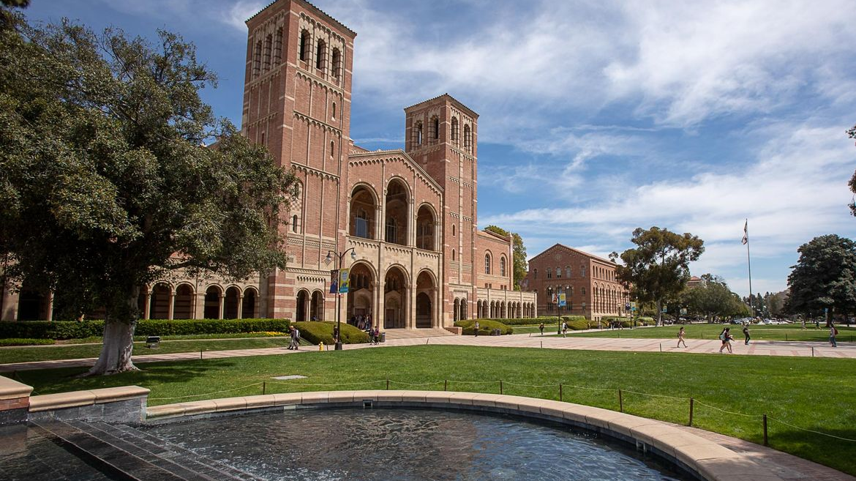
Thank you!

